Slide 1
Welcome to Marketing Management
Dr. Cecilia Ruvalcaba
BUSI 107 Week 2, Day 3

Slide 2
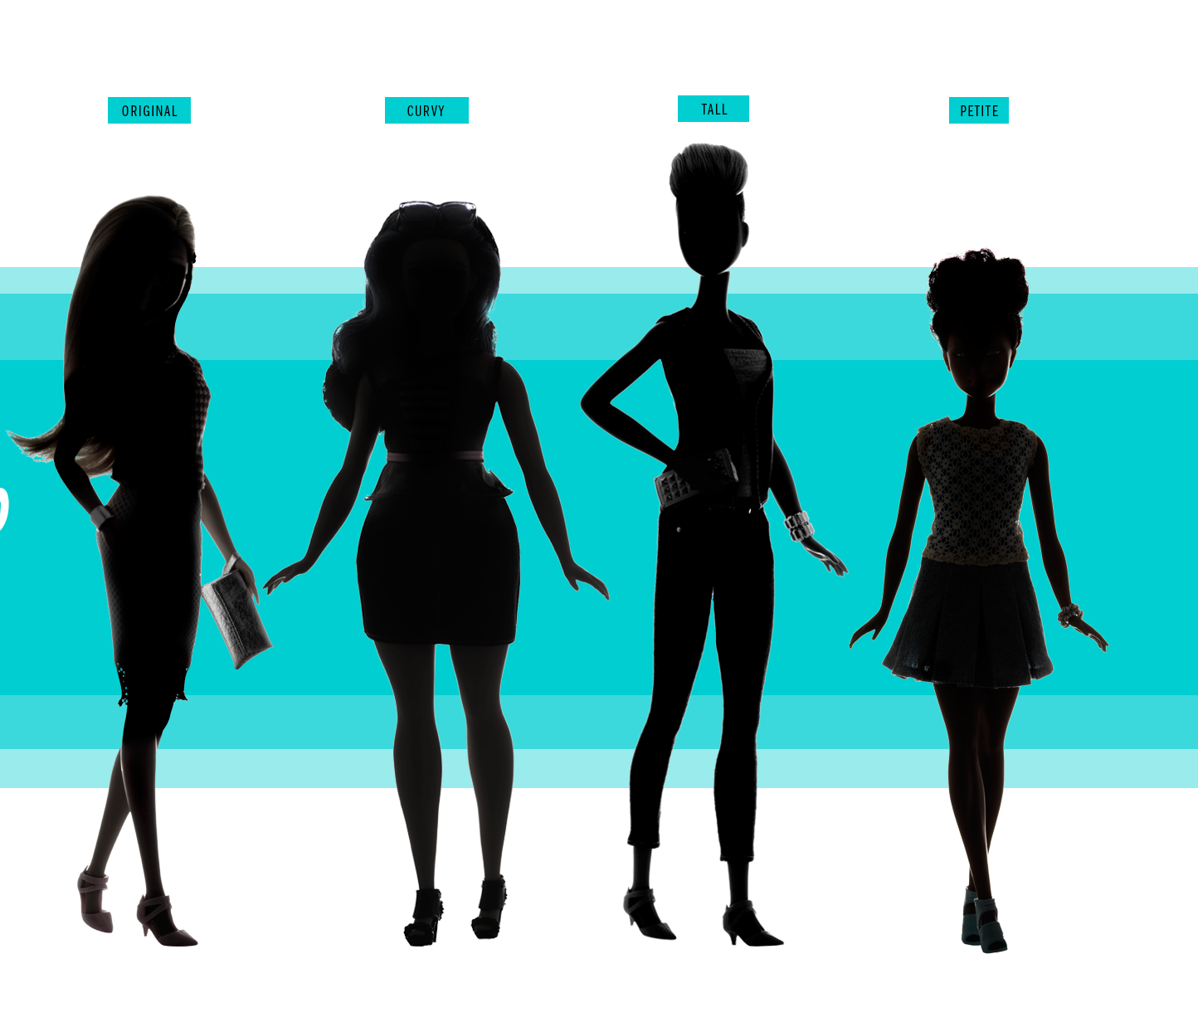

Barbie’s Got a New Body
Notes:
Barbie’s Got a New Body: http://time.com/barbie-new-body-cover-story/ (Video 5:05min)
CNN: http://www.cnn.com/2016/01/28/living/barbie-new-body-feat/

Slide 3
Chapter 10: Marketing Research

Slide 4

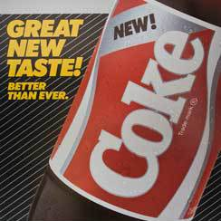
Marketing Research
Marketing research is traditionally defined as the
systematic gathering, recording, and analyzing of
data to provide information useful to marketing decision making.
Aids decision making and is not a substitute for it
Can reduce risks associated with managing marketing strategies
Vital for investigating the effects of various marketing strategies after implementation

Slide 5
The Research Process
Defining the objectives and research needs
Designing the research
Collecting the data
Analyzing data and developing insights
Developing and implementing an action plan

Slide 6

Defining the Problem and Establishing Research Objectives
Type of Research (Country, Market, Consumer)
What is your purpose and goals?
(1) the area of inquiry,
(2) how an understanding of it is to be developed,
(3) what the client hopes to accomplish by understanding the research topic.
What is your research topic/question?
Most Critical Step!
Specify a topic but allow room for discovery.
Topic must be well-defined and suitably delimited to execute within the time and budget available.

Slide 7
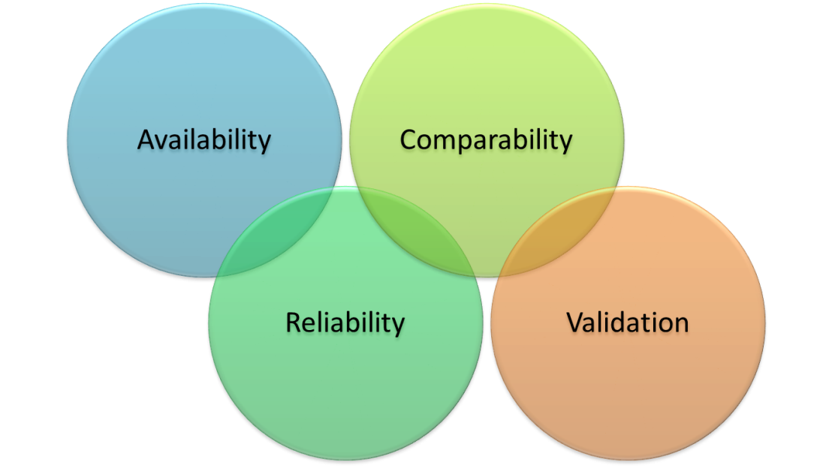
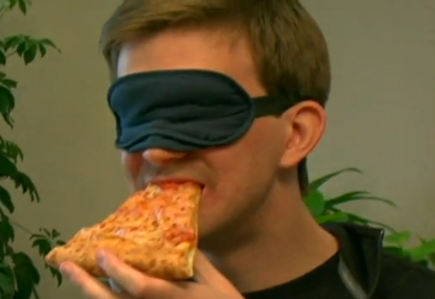

Sources of Information:
Secondary
Data collected for some other purpose
that is subsequently used in a
research project.
Primary
Data originating from a researcher and collected to provide information relevant to a specific research project.
Quantitative Research: Qualitative Research:
Ex. Consumer Product Testing Ex. Consumer Product Use

Slide 8
Interpret and Communicate Findings
Interpretation-> Cultural Understanding
Skepticism
The meanings of words, the consumer’s attitude toward a product, the interviewer’s attitude, or the interview situation can distort research findings.
What does it all mean?
Correlation vs. Causation

Slide 9
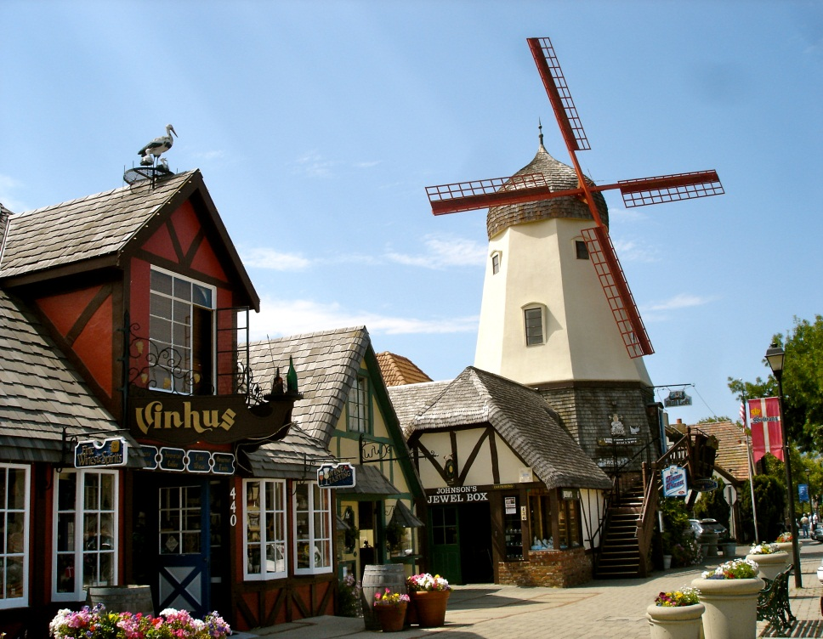
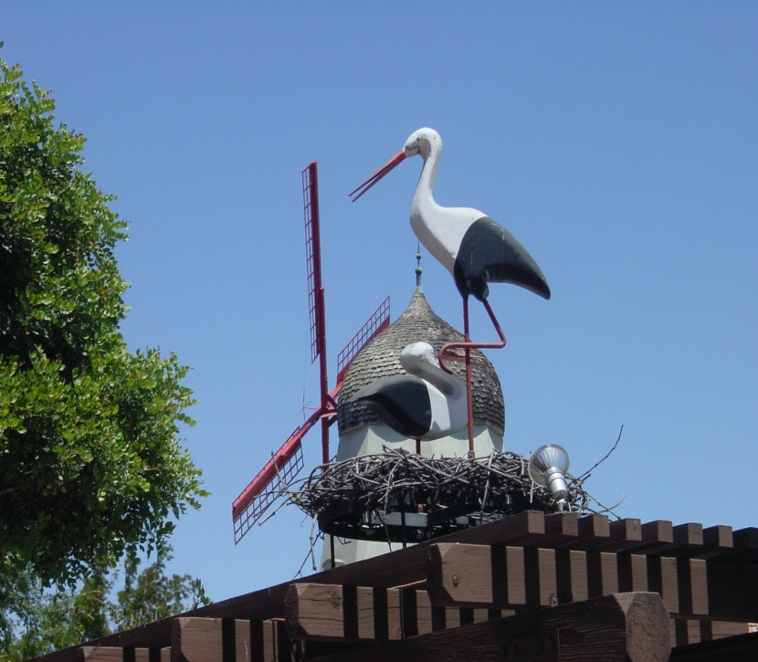
Correlation and Causation
Correlation = relationship between two variables
Causation = one variable producing an effect in another variable
Correlation ≠ Causation
Correlation
Temporal Antecedence
No third factor driving both

Slide 10

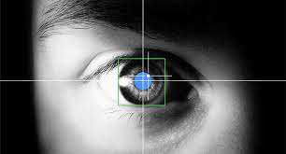
Different Types of Research
Quantitative
Experimental
Mathematical Modeling
Scanner Data
FMRI
Eye Tracking
Surveys…
Qualitative
Interviews
Observation/ Participant Observation
Focus Groups
Netnography
Videography
Historical research…

Slide 11
Illustration of Experimental Method in Comparing Effectiveness of Two Ads
Difference in response between two groups
Groups of people are similar except for the ad they see
Half of the people see Ad #1
Average for group who saw Ad #1 = 3.2
Representative group of customers
Half of the people see Ad #2
Average for group
who saw Ad #2 = 4.6
1
2
3
4
5
Average product interest rating by group
Notes:
This slide refers to material on pp. 186-187.
→ Indicates place where slide “builds” to include the corresponding point (upon mouse click).

Slide 12
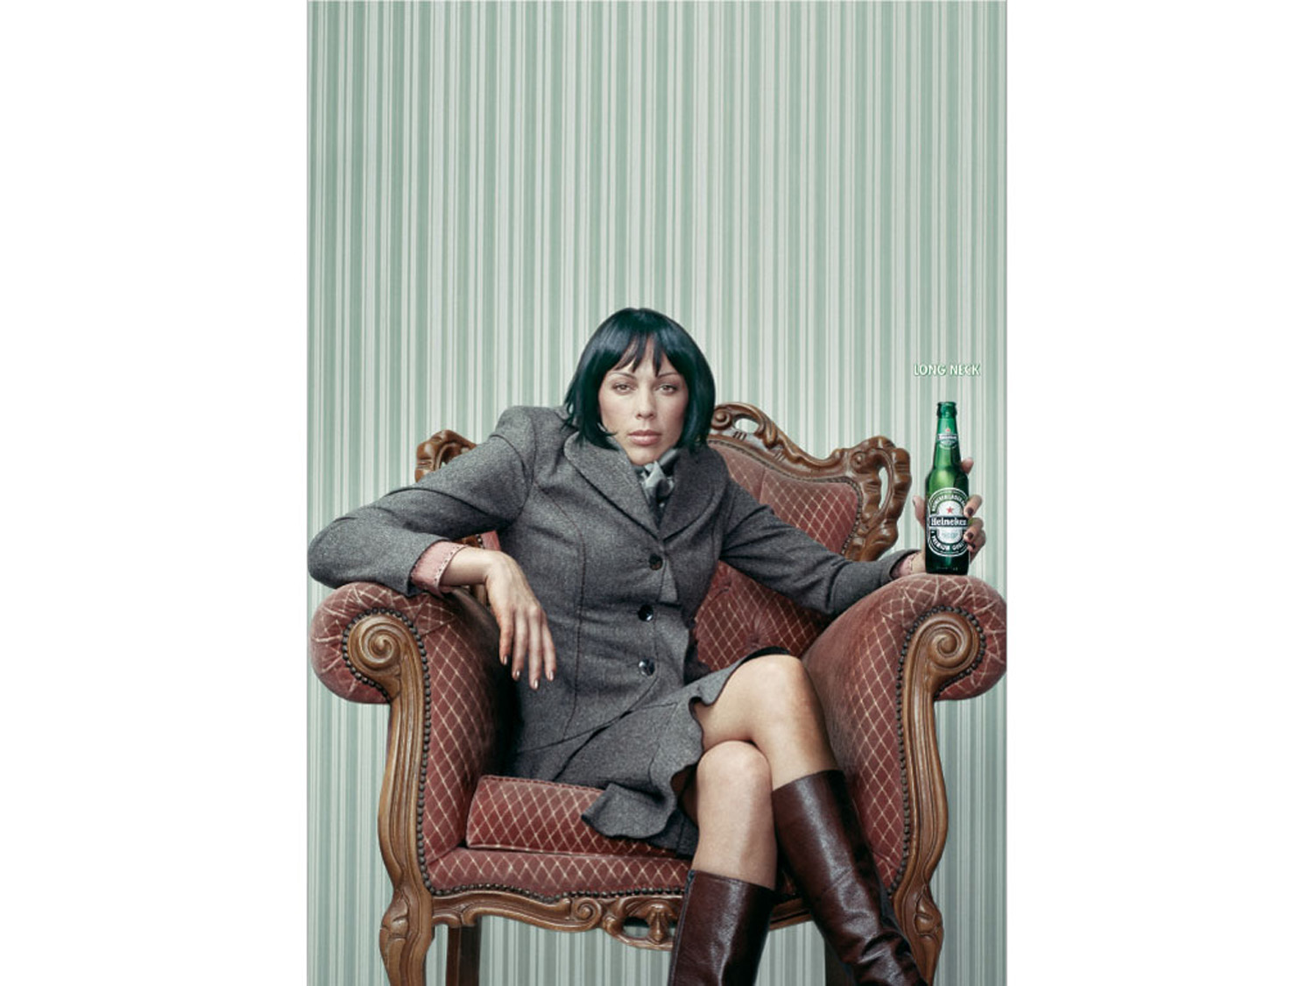

Slide 13
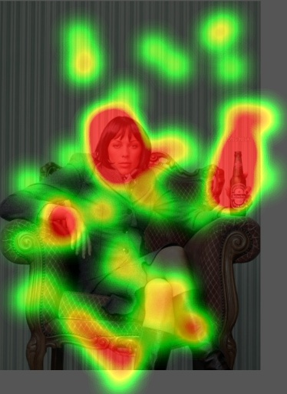
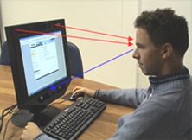

Eye tracking Hot Spot Map
Notes:
http://www.tobii.com/en/eye-tracking-research/global/library/videos/all/package-testing/

Slide 14
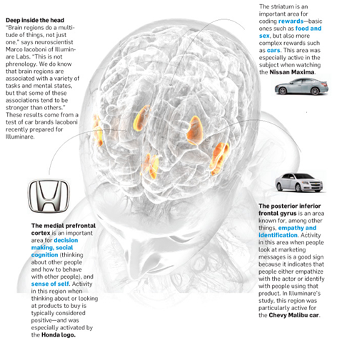

Slide 15


Take Away for Today
Marketing Research… Make sure to ask the right questions.
Correlation ≠ Causation
Marketing Data- Don’t ignore the opportunities

Slide 16

Next Class
Chapter 10: Marketing Research cont…
Wednesday February 22.
Library Database Session w/ Jack Schroeder

